Slide 1
Digital Portfolio
STUDENT NAME: Thamem ansari S
REGISTER NO AND NMID: asunm1112401111058051
DEPARTMENT: computer science
COLLEGE: L.N.Givernment college,Madras University.

Slide 2
PROJECT TITLE
Digital Portfolio using front end web development

Slide 3


AGENDA
Problem Statement
Project Overview
End Users
Tools and Technologies
Portfolio design and Layout
Features and Functionality
Results and Screenshots
Conclusion
Github Link
3/21/2024 Annual Review

Slide 4

PROBLEM STATEMENT
A personal portfolio website serves as a digital identity for professionals, showcasing their skills, projects, and expertise. In today's competitive job market, developers and tech enthusiasts need a platform to present themselves and their work to potential clients or employers. This portfolio website solves the problem of providing a professional and well-structured space for individuals to demonstrate their technical proficiency and creativity, allowing them to stand out.

Slide 5

PROJECT OVERVIEW
This portfolio website is designed for Thamem Ansari, a web developer. It includes sections like Home, About, Projects, and Contact. The website highlights Thamem's skills, past work, and ways to get in touch, providing potential employers or clients with an overview of his capabilities. The design focuses on clean and modern aesthetics, with responsive features ensuring it works well across different devices. The website also includes interactive features like a contact form and a mobile-friendly navbar.

Slide 6

WHO ARE THE END USERS?
1. Potential Employers: Looking for a skilled web developer to hire.2. Clients: In need of web development services.3. Fellow Developers: Interested in collaboration or networking.4. Visitors: Anyone interested in learning more about Thamem's work or seeking inspiration for their own portfolios.

Slide 7

TOOLS AND TECHNIQUES
HTML5: For structuring the content of the website.CSS3: For styling and layout, including responsive design features using media queries.JavaScript: For interactivity, like the mobile navbar toggle and form validation.Responsive Design: Ensures the website looks good on any device.Visual Studio Code: For writing and editing the code.GitHub Pages: For hosting the website (or any other hosting service).Figma/Adobe XD (Optional): For initial design mockups.

Slide 8
POTFOLIO DESIGN AND LAYOUT
1. Hero Section: An eye-catching introduction with a call-to-action button.242. About Section: A brief introduction to Thamem, including a photo and a short bio.3. Projects Section: Showcases previous work with descriptions of each project.4. Contact Section: A simple form to allow visitors to reach out directly.5. Sticky Navbar: A navigation menu that remains at the top as the user scrolls.
8

Slide 9
FEATURES AND FUNCTIONALITY
1. Responsive Layout: Adjusts according to screen size for better accessibility on mobile devices.2. Interactive Navbar: Includes a hamburger menu for mobile screens.3. Contact Form: Users can submit their details or queries, with real-time validation feedback.4. Project Grid: Displays projects in a grid layout for easy viewing, with hover effects.5. Modern UI: Uses gradients, buttons, and well-chosen typography for a sleek look

Slide 10
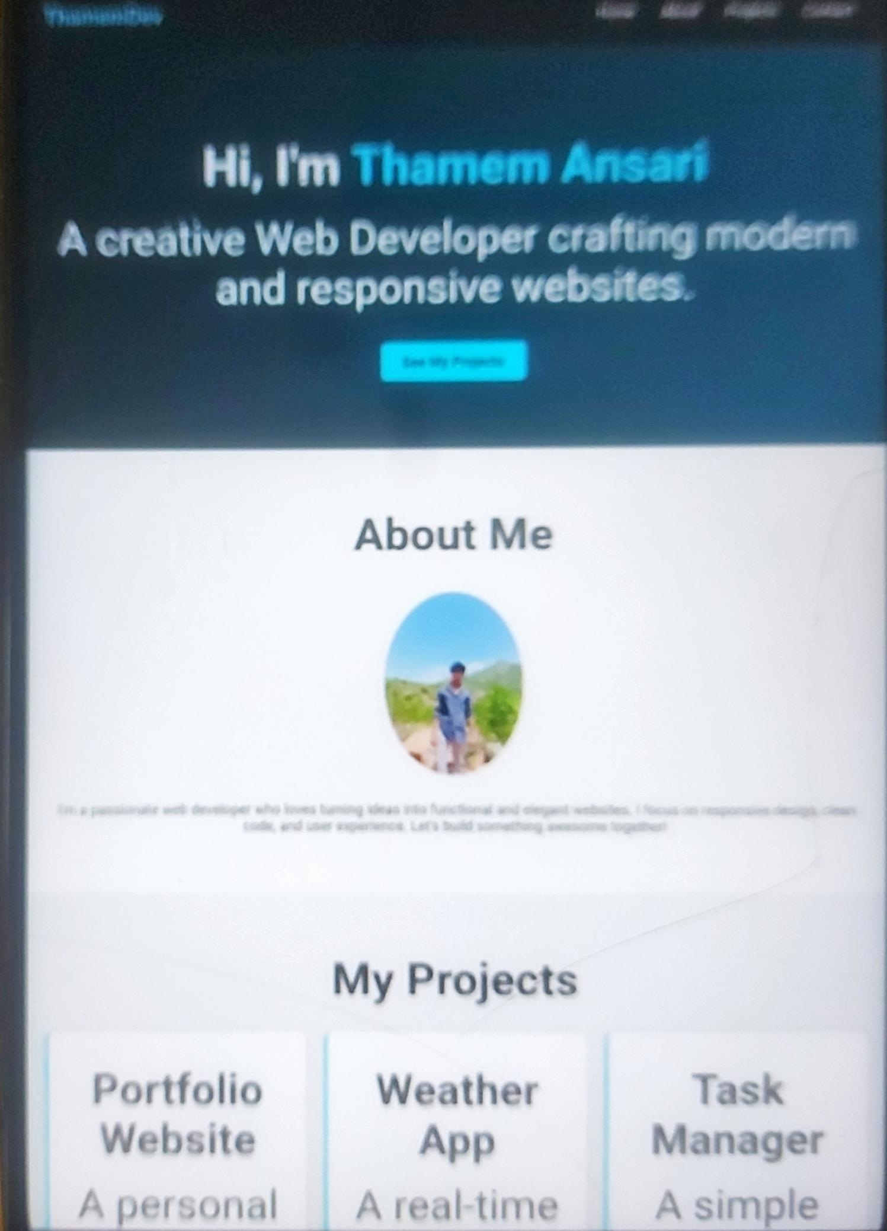
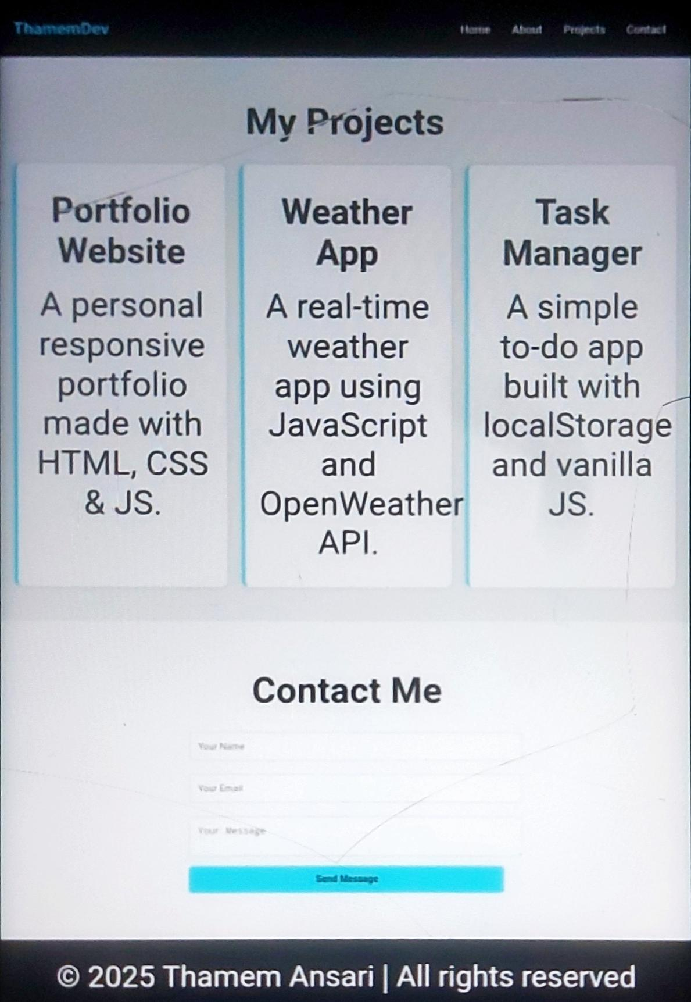

RESULTS AND SCREENSHOTS
3/21/2024 Annual Review
10

Slide 11
CONCLUSION
This portfolio website effectively showcases Thamem Ansari's work, skills, and contact information in an elegant, user-friendly manner. The modern design, combined with responsive features, ensures the portfolio looks great on both desktop and mobile devices. With a focus on clean code and interactive elements, it offers a smooth and engaging experience for visitors, whether they're potential employers, clients, or fellow developers. This portfolio serves as a strong personal branding tool and can be easily updated as Thamem continues to grow professionally.
11

Slide 12
Github link
https://ismailsydhali071-dev.github.io/RNSDC-FWD-DP/

